Slide 1
SIMPLE NETWORK MANAGEMENT PROTOCOL (SNMP)

Slide 2
Network Management
Monitoring, testing, configuring and trouble-shooting network components to meet a set of requirements defined by an organization.

Slide 3
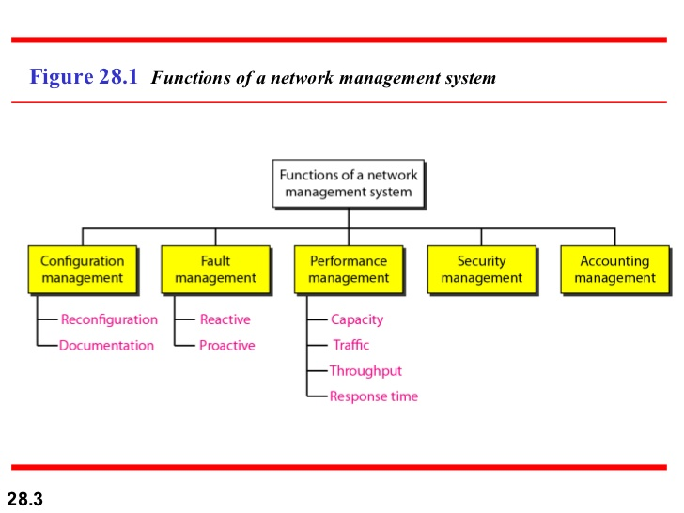

Slide 4
SNMP
Is a framework for managing devices in an internet using the TCP/IP Protocol suite.
Provides a set of fundamental operations for monitoring and managing an internet.
SNMP uses the concept of manager and agent.
That is, a manager, usually a host, controls and monitors a set of agents, usually routers or servers.
It can be used in a heterogeneous internet with different LANs and WANs connected by routers made by different manufacturers.

Slide 5
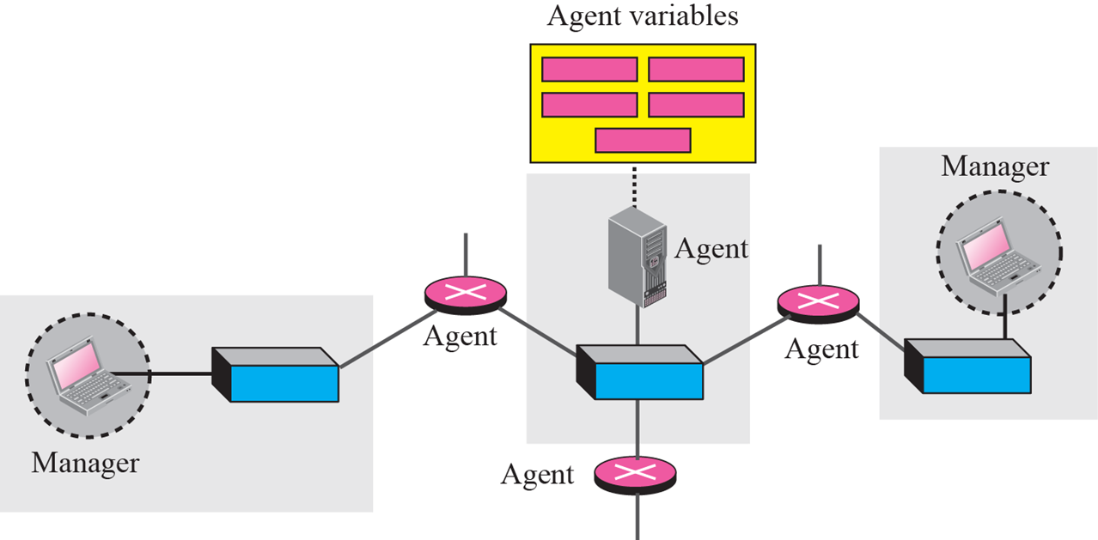

Slide 6
Managers and agents
Manager
That runs SNMP client program.
A manager can checks an agent by requesting information from agent.
It can forces an agent to perform a task by resetting values in agent db.

Slide 7
Agent:
Managed station.
Normally a router that runs the SNMP server program.
It keeps performance information in a database.
Server program running on agent can check the environment, if notices something unusual, it can send warning message (trap), to manager.

Slide 8
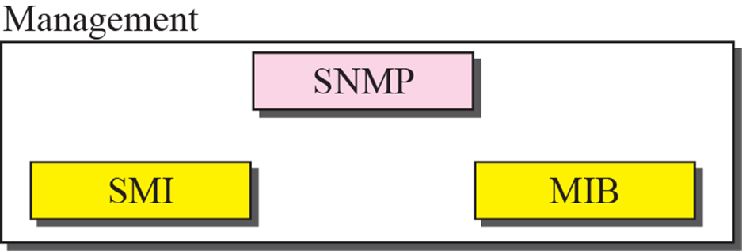
Management components
To do management tasks, uses 2 protocols:
*Structure of Management Information (SMI)
*Management Information Base(MIB)

Slide 9
Role of SNMP
SNMP defines the format of packets exchanged between a manager and an agent.
It reads and changes the status of objects (values of variables) in SNMP packets.

Slide 10
Role of SMI
Role of MIB
Define rules for naming objects, defining object type, and showing how to encode objects and values.
MIB creates a collection of named objects, names them according to the rules defined by SMI.
MIB creates a collection of named objects, their types and their relationships to each other in an entity to be managed.

Slide 11
To understand more
We can compare the task of network management to the task of writing a program.
❏ Both tasks need rules. In network management this is handled by SMI.
❏ Both tasks need variable declarations. In network management this is handled by MIB.
❏ Both tasks have actions performed by statements. In network management this is handled by SNMP.

Slide 12
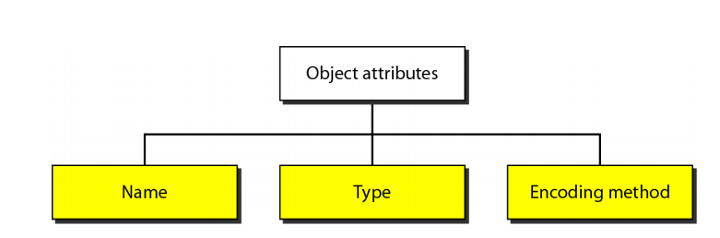
SMI in detail
SMI v2 is a component for network management. Its function are:
To name objects.
To define the type of data that can be stored in an object.
To show how to encode data for transmission over the network.
SMI is a guideline for SNMP, it emphasizes 3 attributes to handle an object: name, datatype, encoding method.

Slide 13
Name
To name objects globally, SMI uses an object identifier, which is hierarchical.
Starts with an unnamed root (next slide).
Each object can be defined by using a sequence of integer separated by dots.
The tree structure can also define an object by using a sequence of textual names separated by dots.

Slide 14
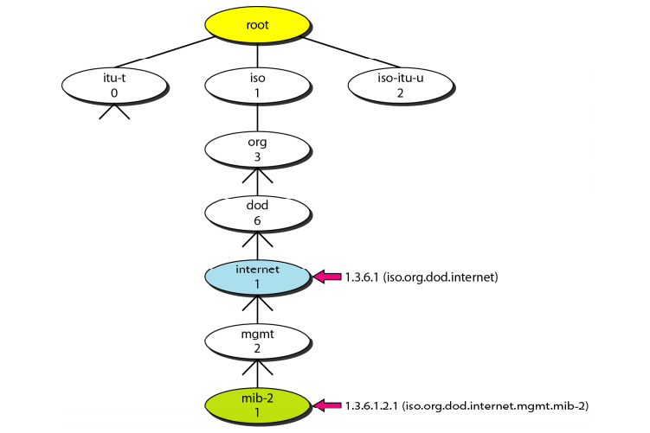

Slide 15
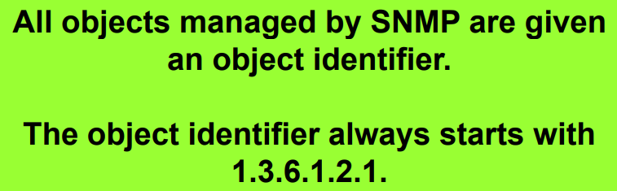

Slide 16
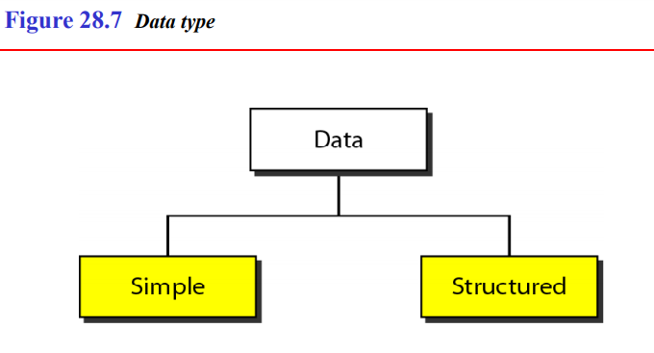
Type

Slide 17
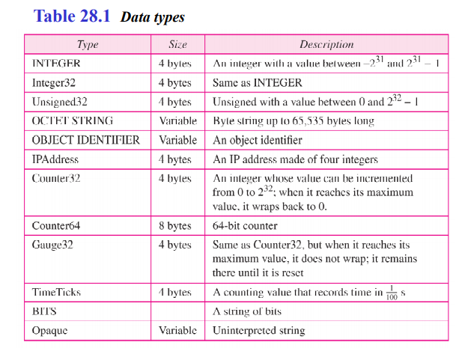
Simple
Atomic datatypes.
Some of them taken from ASN.1
Others are added by SMI.

Slide 18
Structured Type
SMI defines 2 structured datatypes:- sequence, sequence of
By combining simple and structured data-types, we can make new structured data-types.
Sequence: it is analogous to the concept of struct or a record in programming language .
Sequence of: analogous to array

Slide 19
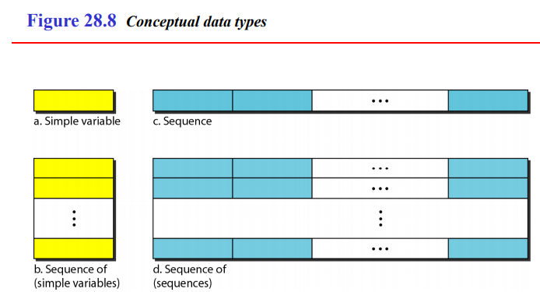

Slide 20
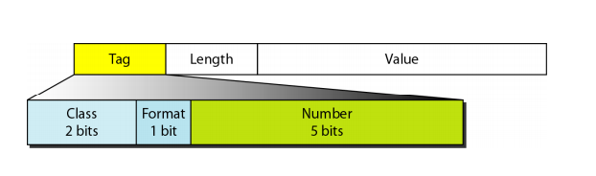
Encoding Method
Format

Slide 21
Tag : 1 byte
Defines type of data
Composed of 3 sub field
Class (2 bits)
Format(1 bit)
Number (5 bits)
4 classes
Universal(00) :taken from ASN.1
Application wide(01): added by SMI
Context-specific(10): meaning change from protocol to protocol
Private(11): are vendor -specific

Slide 22
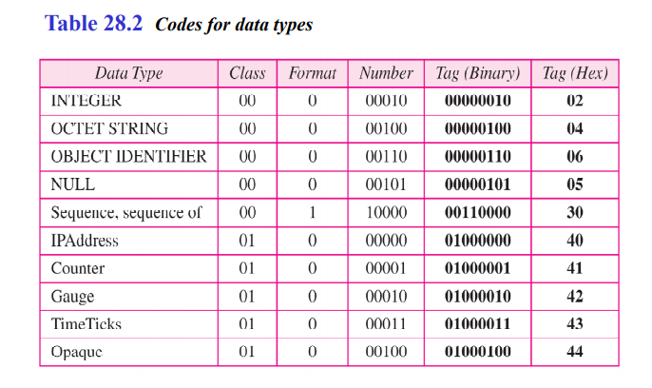

Slide 23
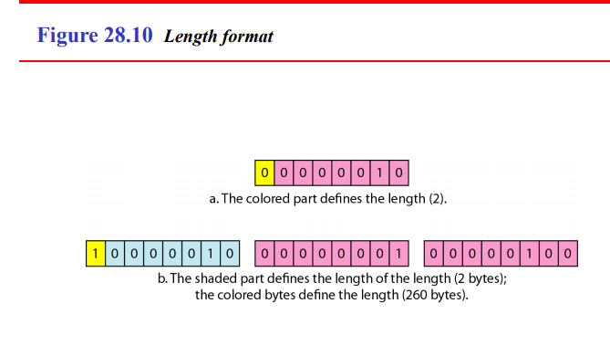

Slide 24
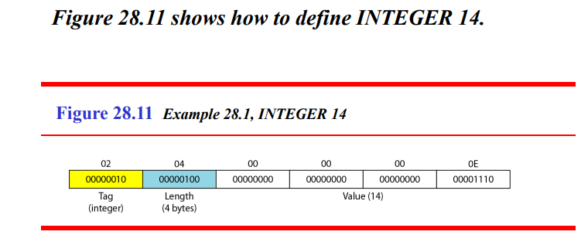

Slide 25
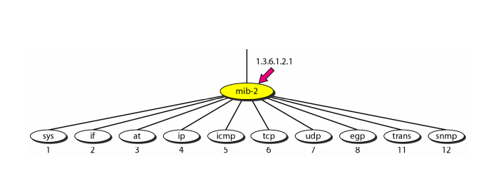
MIB v2
NB: Read description of each object

Slide 26
Lexicographic ordering
MIB variables, object identifiers follow lexicographic order.
Lexicographic ordering enables a manager to access a set of variables one after another by defining the first variable.

Slide 27
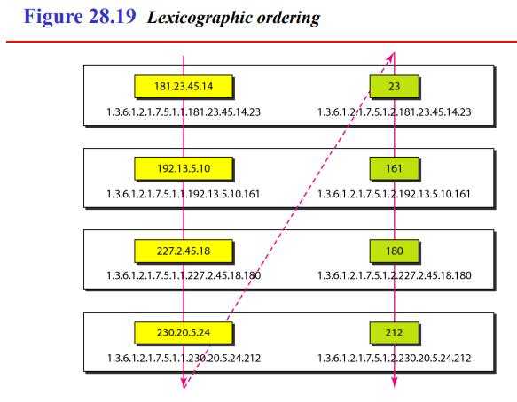

Slide 28
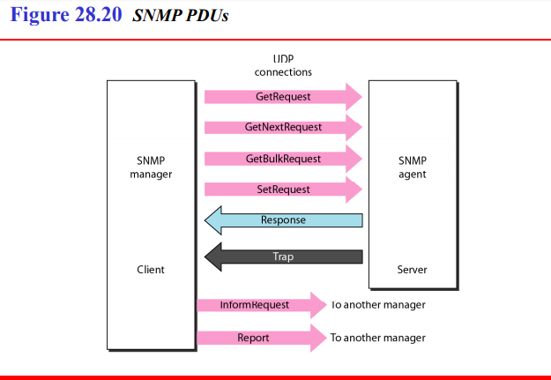
SNMP PDUs

Slide 29
GetRequest :
A manager-to-agent request to retrieve the value of a variable or list of variables.
Desired variables are specified in variable bindings (the value field is not used).
Retrieval of the specified variable values is to be done as an atomic operation by the agent.
A Response with current values is returned.
SetRequest:
A manager-to-agent request to change the value of a variable or list of variables.
Variable bindings are specified in the body of the request. Changes to all specified variables are to be made as an atomic operation by the agent.
A Response with (current) new values for the variables is returned.

Slide 30
GetNextRequest:
A manager-to-agent request to discover available variables and their values.
Returns a Response with variable binding for the lexicographically next variable in the MIB.
The entire MIB of an agent can be walked by iterative application of GetNextRequest starting at OID 0.
Rows of a table can be read by specifying column OIDs in the variable bindings of the request.
GetBulkRequest :
A manager-to-agent request for multiple iterations of GetNextRequest.
An optimized version of GetNextRequest.
Returns a Response with multiple variable bindings walked from the variable binding or bindings in the request.
PDU specific non-repeaters and max-repetitions fields are used to control response behavior.
GetBulkRequest was introduced in SNMPv2

Slide 31
Response:
Returns variable bindings and acknowledgement from agent to manager for GetRequest, SetRequest, GetNextRequest, GetBulkRequest and InformRequest.
Error reporting is provided by error-status and error-index fields.
Although it was used as a response to both gets and sets, this PDU was called GetResponse in SNMPv1.
Trap:
Asynchronous notification from agent to manager.
While in other SNMP communication, the manager actively requests information from the agent, these are PDUs that are sent from the agent to the manager without being explicitly requested.
SNMP traps enable an agent to notify the management station of significant events by way of an unsolicited SNMP message.
Trap PDUs include current sysUpTime value, an OID identifying the type of trap and optional variable bindings.
Destination addressing for traps is determined in an application-specific manner typically through trap configuration variables in the MIB. The format of the trap message was changed in SNMPv2 and the PDU was renamed SNMPv2-Trap.

Slide 32
InformRequest:
Acknowledged a synchronous notification. This PDU was introduced in SNMPv2 and was originally defined as manager to manager communication.
Later implementations have loosened the original definition to allow agent to manager communications.

Slide 33
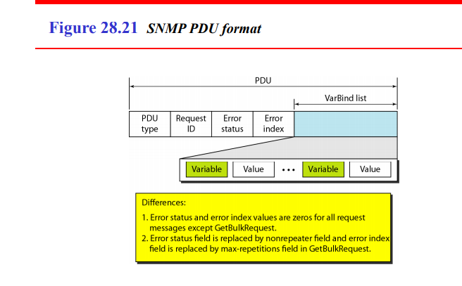

Slide 34
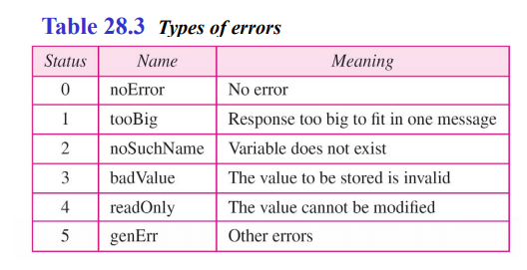

Slide 35
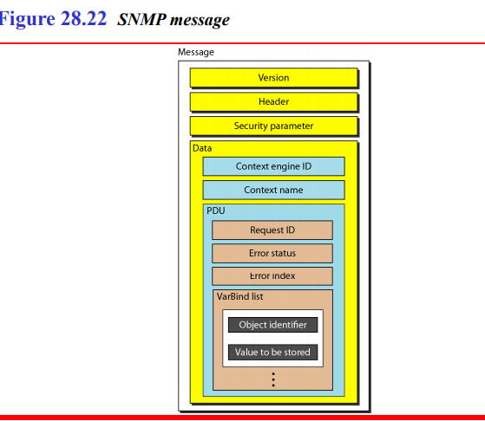

Slide 36
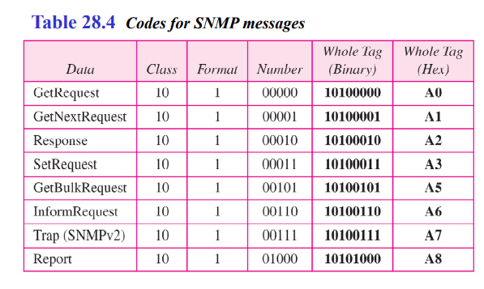

Slide 37
